Slide 1
55 years old female presented to us with SOB at rest, chest pain on minimal exertion sheis known case of HTN was diagnosed with heart failure with reduced ejection fraction for 1 year ago and recurrent hospital admission And on this admission she was admitted as a case of pulmonary oedema
On examination
Patient was middle age lying flat
Mildly dyspnic
Pulse rate 70 bpm
Blood pressure 150/90 mmhg
Cardiac examination heaving apex beat
Ejection systolic murmer at LLSB
Positive family history of cardiac disease
ECG voltage LVH and non specific ST T changes

Slide 2
Hypertrophic cardiomyopathies
Dr. Mohammed adel
F.I.B.M.C – M.B.Ch.C
University of Basra- Al zahraa teaching hospital

Slide 3
Hypertrophic cardiomyopathy (HCM) is a genetically determined heart muscle disease most often caused by mutations in one of several sarcomere genes that encode components of the contractile apparatus.
HCM is characterized by left ventricular hypertrophy (LVH) of various morphologies, with a wide array of clinical manifestations and hemodynamic abnormalities Depending in part upon the site and extent of cardiac hypertrophy, patients with HCM can develop one or more of the following abnormalities:
LV outflow obstruction
Diastolic dysfunction
Myocardial ischemia
Mitral regurgitation
In broad terms, the symptoms related to HCM can be categorized as those related to heart failure (HF), chest pain, or arrhythmias. For the majority of patients with HCM,

Slide 4
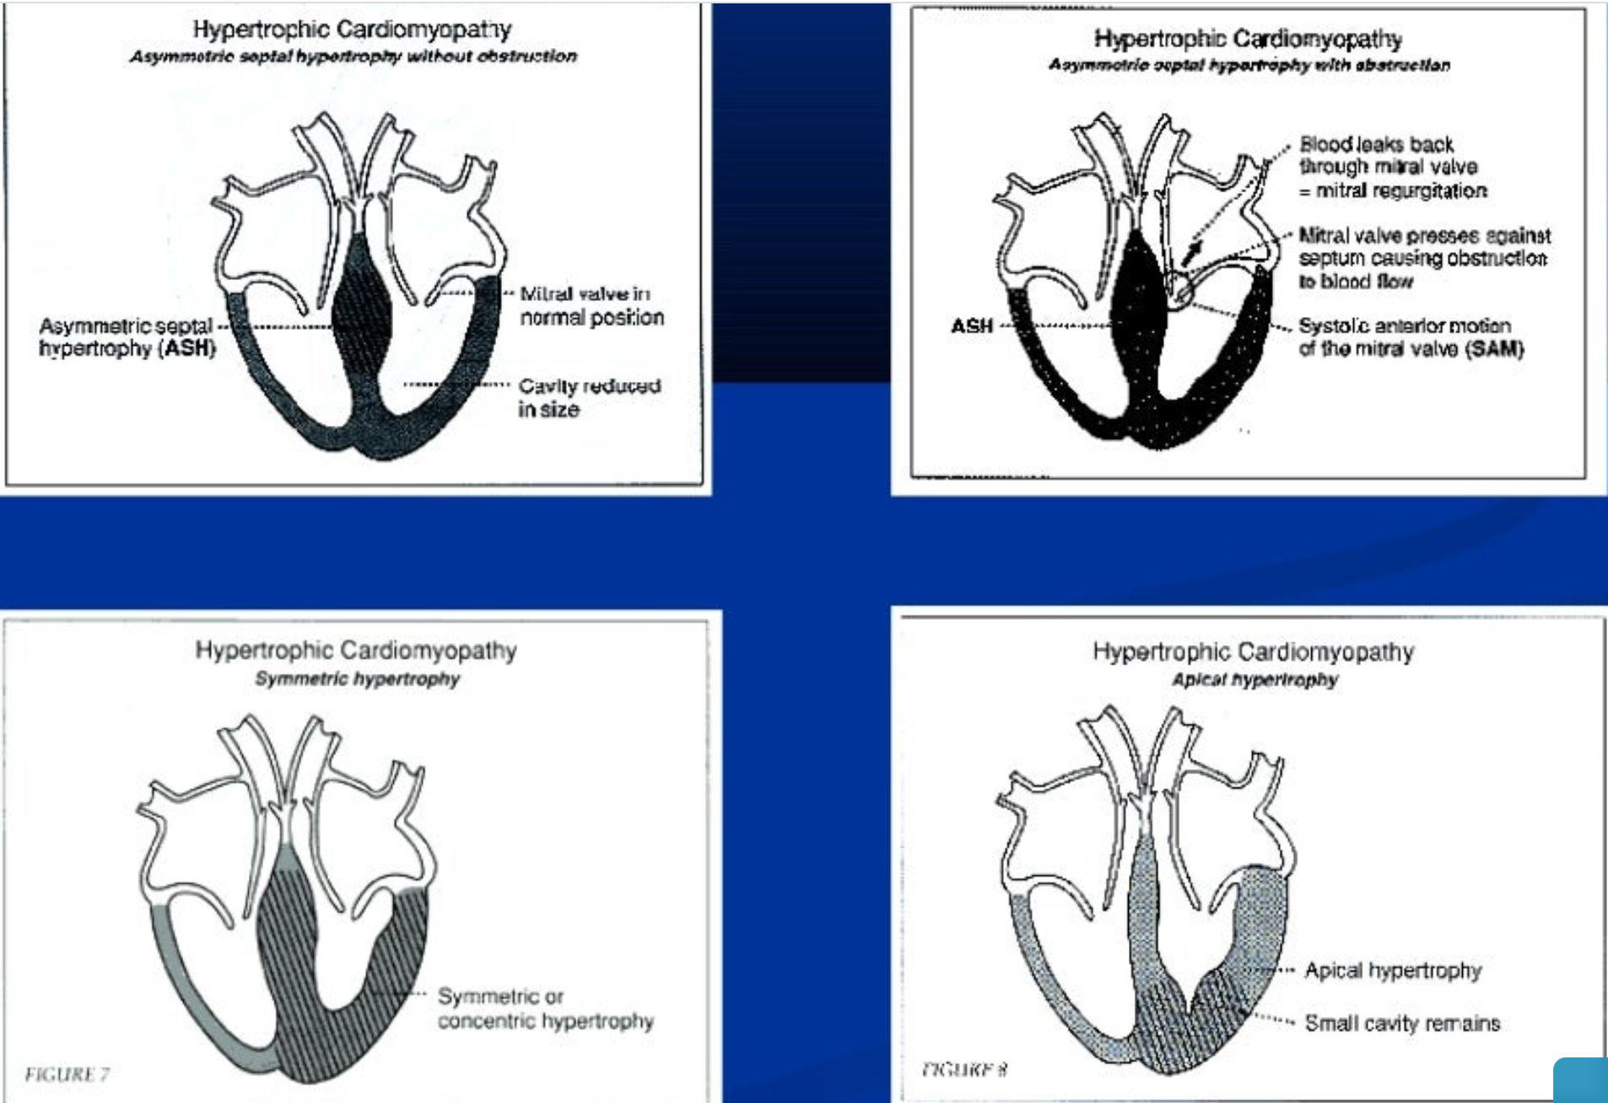

Slide 5
Pathophysiological changes in HOCM:
Increase intraventricular pressure
Prolong ventricular relaxation
Increase myocardial wall stress
Increase oxygen demand
Decrease LVOT

Slide 6
Clinical presentation:
Dyspnoea (90%), orthopnoea and PND
Palpitation
CHF
Angina (70-80%)
Syncope and presyncpe
Sudden cardiac can be the first clinical manifestation

Slide 7
Physical examination:
Carotid pulse (bifid )
JVP (prominent a wave )
Apical beat ( double or triple)
Heart sound:
S1 normal
S2 usually split (reverse )
S3 indicate late stage
S4 usually due hypertrophy
Murmer:
Medium pitch crescendo decrescendo LLSB and apex radiate to suprasternal notch.
SAM with MR

Slide 8
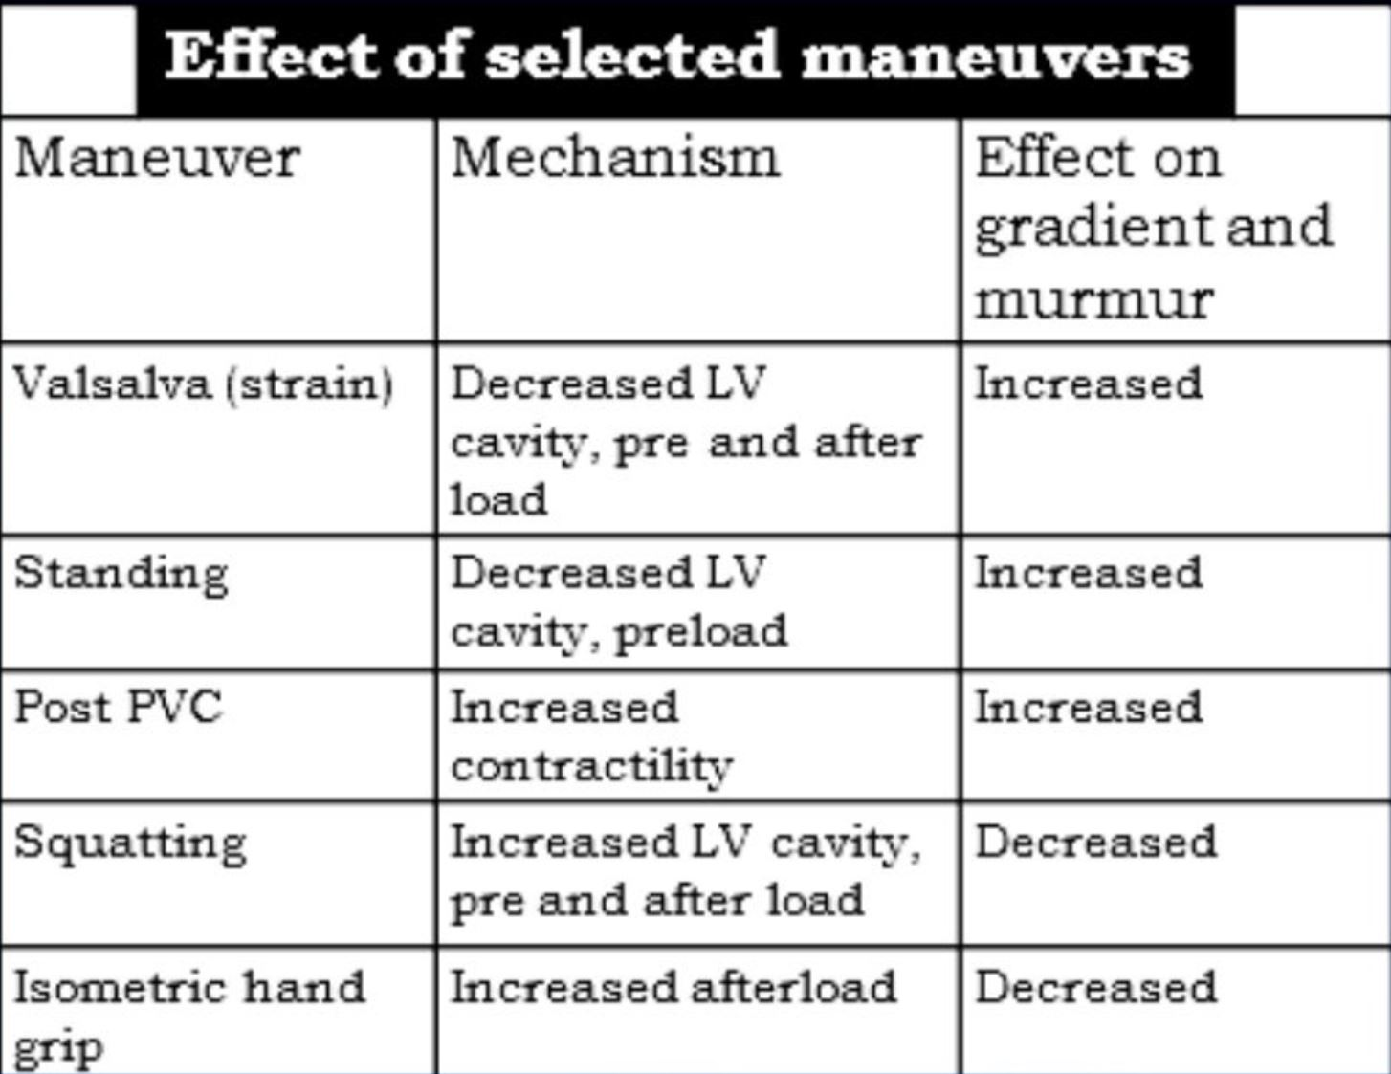
Dynamic maneuverer:
Murmur intensity increase with decrease preload (Valsalva, standing )
Murmur intensity decrease with increase preload (squatting , hand grip)

Slide 9
Diagnosis:
ECG
Echocardiography
Cathetarization
Cardiac imaging

Slide 10
ECG features of HCM
Left ventricular hypertrophy with increased precordial voltages and non-specific ST segment and T-wave abnormalities
Deep, narrow (“dagger-like”) Q waves in lateral (I, aVL, V5-6) +/- inferior (II, III, aVF) leads
Other associated features may include:
Left atrial enlargement(“P mitrale”) — left ventricular diastolic dysfunction may lead to compensatory left atrial hyertrophy
Signs of WPW (short PR, delta wave) — ECG features of Wolff-Parkinson-White (WPW) were seen in 33% of patients with HCM in one study, and at least one genetic mutation has been identified that is associated with both conditions
Dysrhythmias: atrial fibrillation and supraventricular tachycardias are common; PACs, PVCs, VT
Giant precordial T-wave inversions in apical HCM

Slide 11
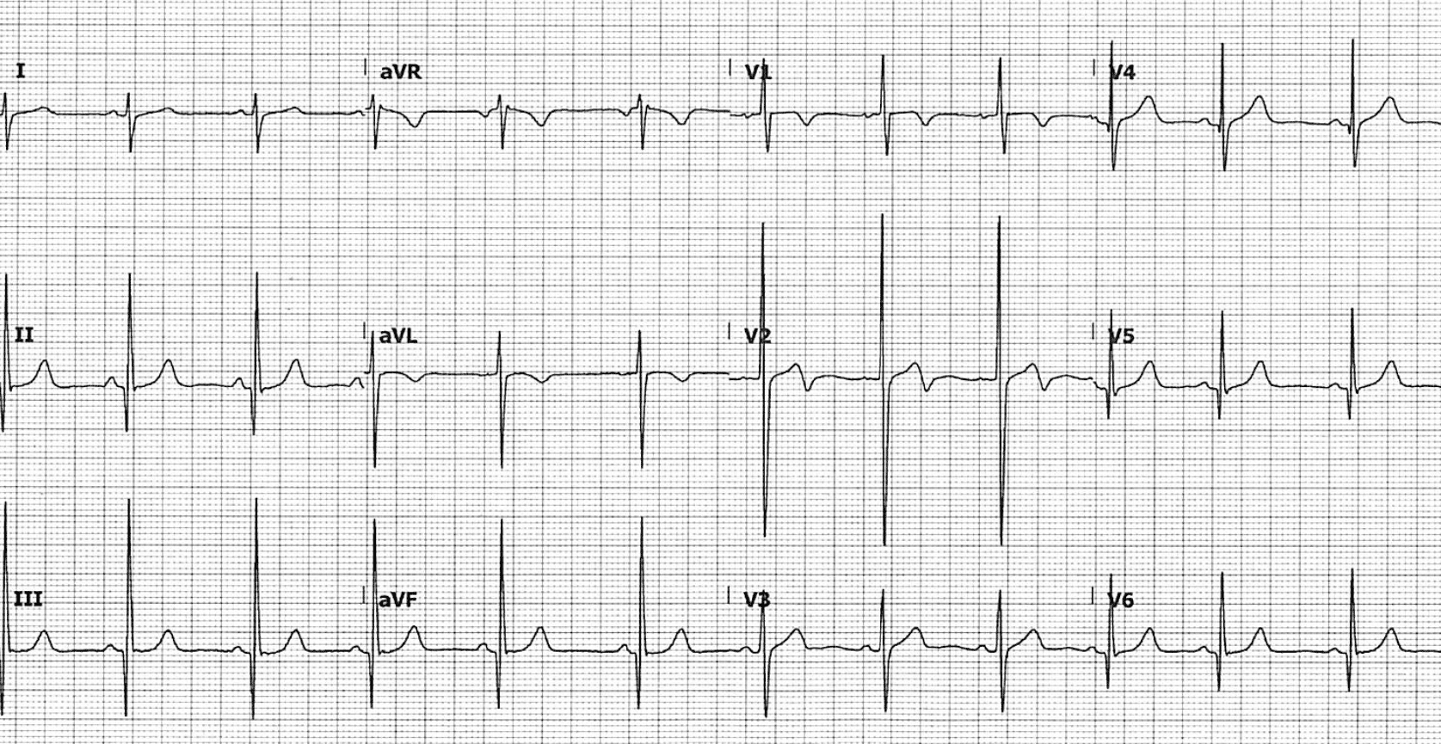

Slide 12
Echo features:
Abnormal systolic motion of anterior leaflet of the mitral valve
LVH
Left atrial enlargement
Diastolic dysfunction
Small ventricular chamber size
Septal wall hypertropthy
Partial closure of the aortic valve in midsystole

Slide 13
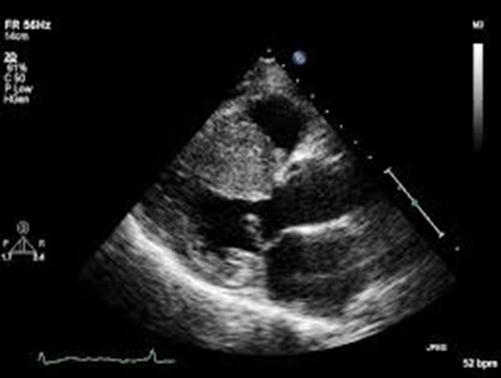

Slide 14
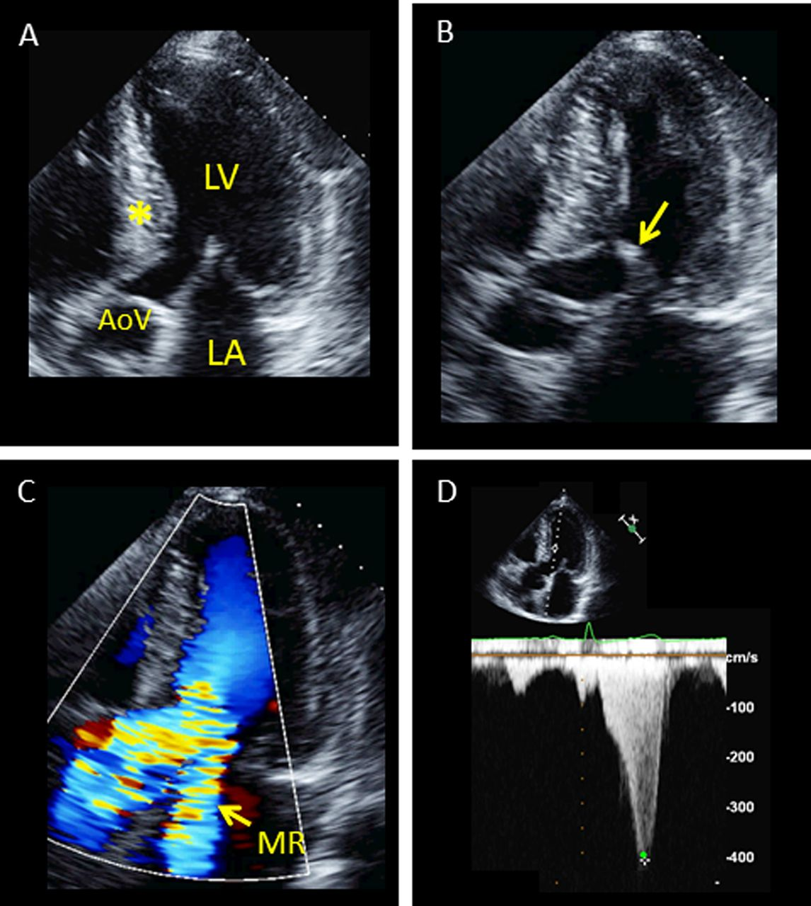

Slide 15
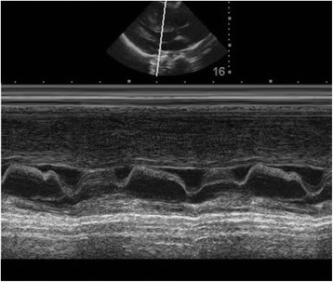

Slide 16
Natural history
Heart failure
Only 15% develop NYHA3 systolic failure
Only 3% develop end stage systolic heart failure
Atrial fibrillation
Develop in 30% in elder patient
Endocarditis
only 3-4% develop endocarditis
Usually mitral valve effected
Autonomic dysfunction
develop in 25% of patients
Poor prognosis

Slide 17
Evaluation:
Family screen
Holter monitor
Exercise test

Slide 18
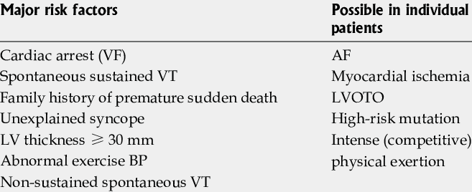
Risk factor

Slide 19
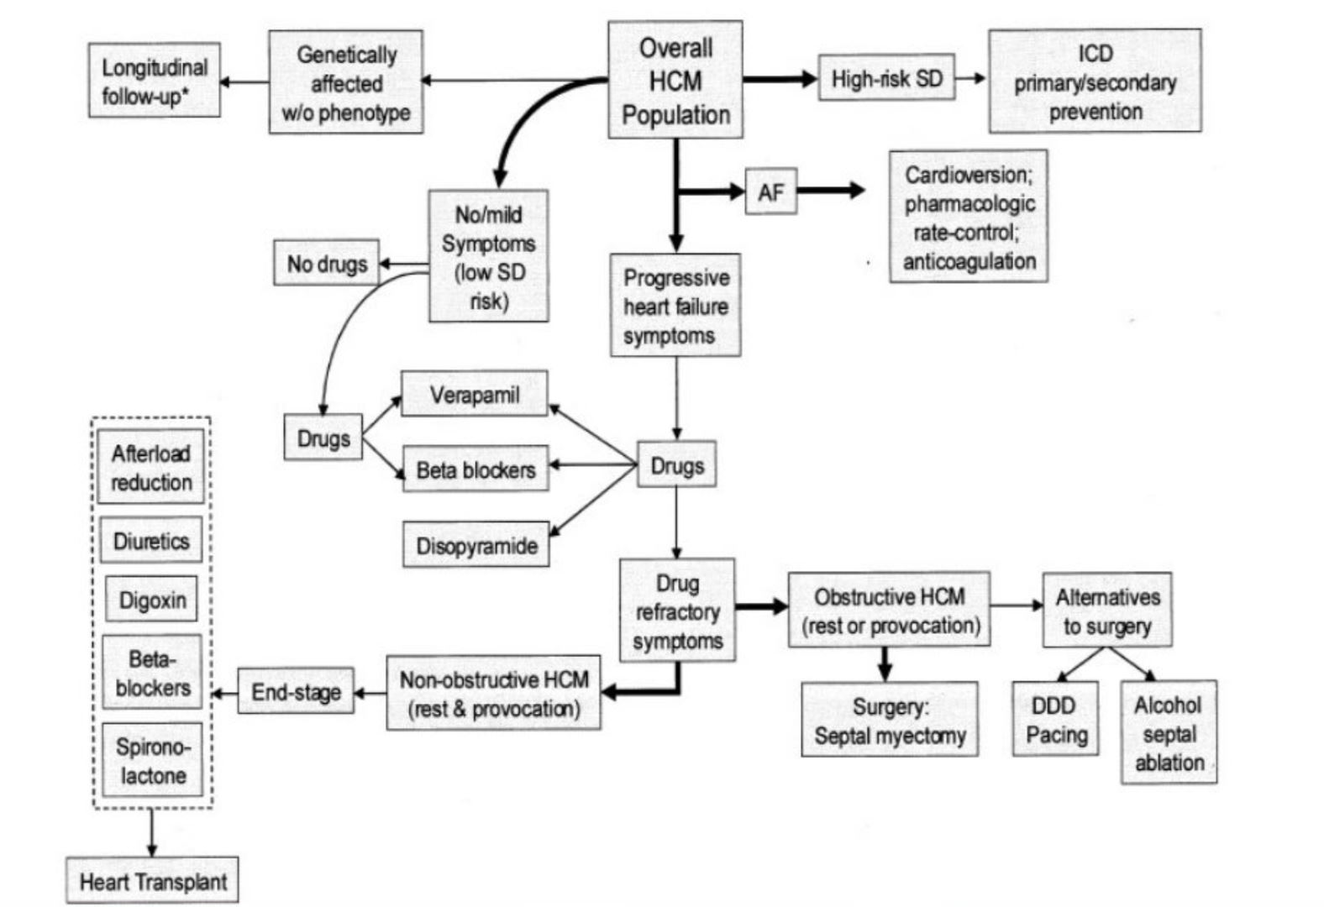

Slide 20
Thank you

